Slide 1
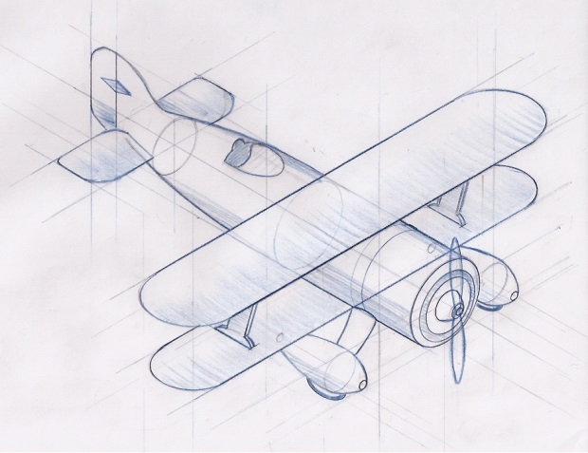
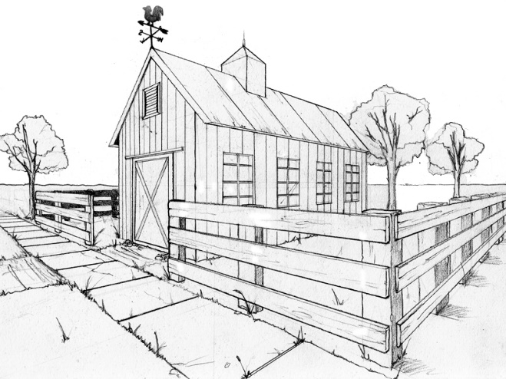
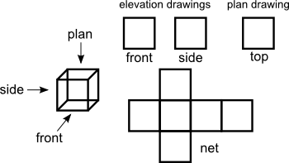
Representing 3D objects in 2D

Slide 2
Nets and Surface Area
Imagine cutting a cardboard box along its edges and laying it out flat. The resulting figure is called a net.
back
=
end
end
top
front
bottom
A net is very helpful in finding the surface area of a solid figure.

Slide 3
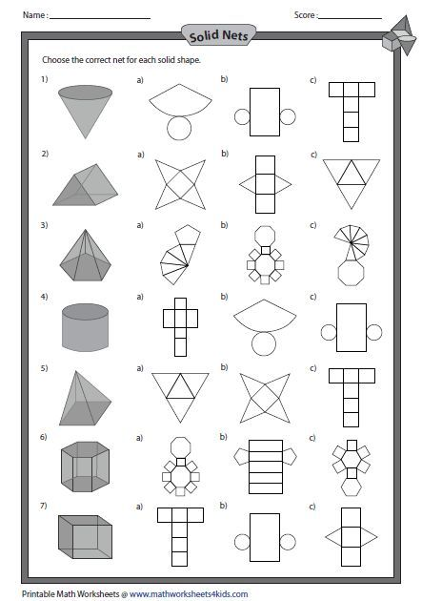

Slide 5
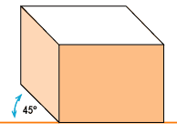
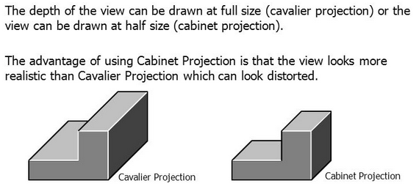
Oblique Views
Oblique projection is a simple type of projection used for producing two-dimensional images of three-dimensional objects
Leading face
Oblique projections have a leading face and lines project back from this face at 45^{O}

Slide 6
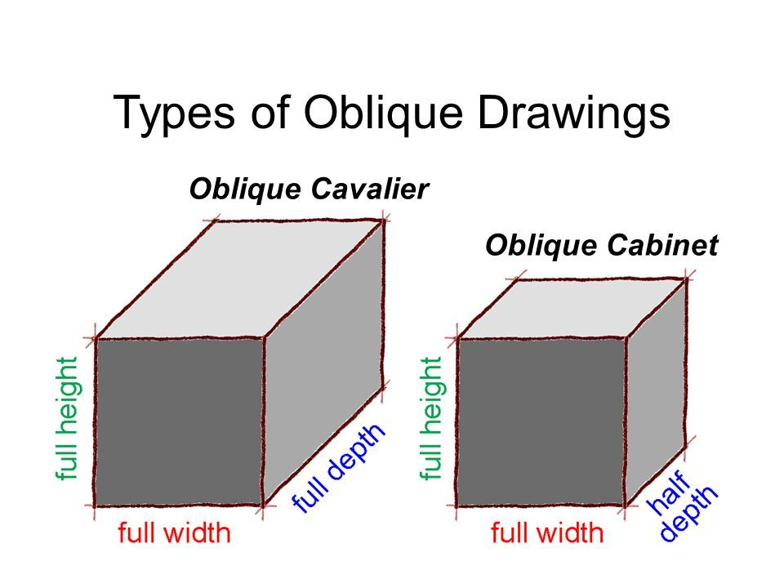

Slide 7
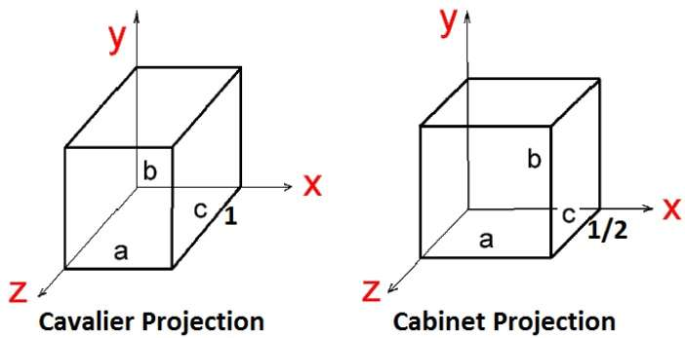
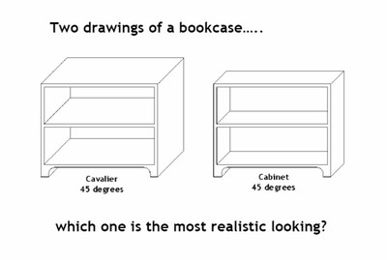

Slide 8
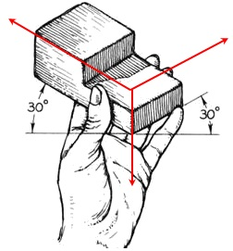
ISOMETRIC DRAWINGS
The object is held with one vertical edge leading, then tilted toward the viewer until the other horizontal edge are at a 30 degree angles.
All three axes are scaled equally at 120 degrees. This is why they are called isometric as “iso” means same and metric means “measure”.
120º
120º
120º

Slide 9
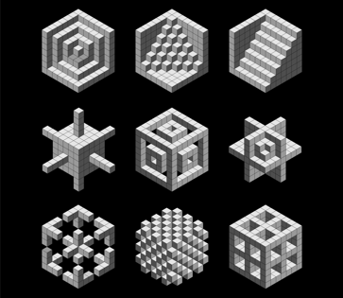

Slide 10
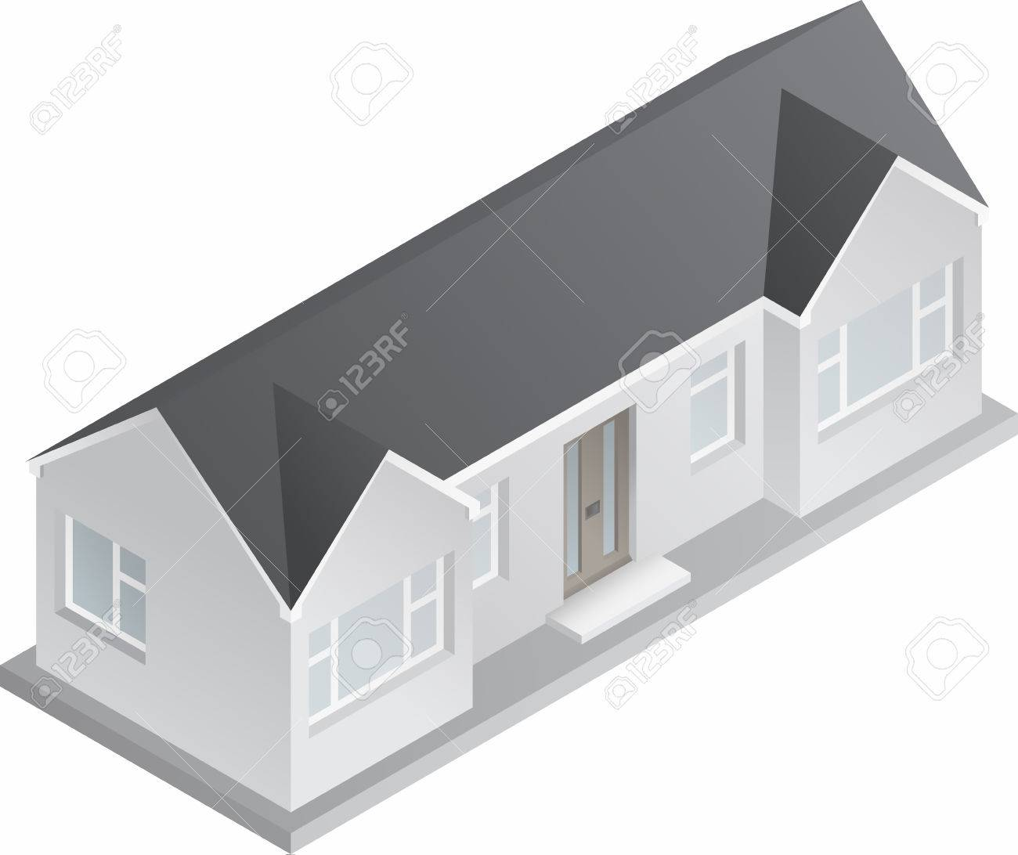
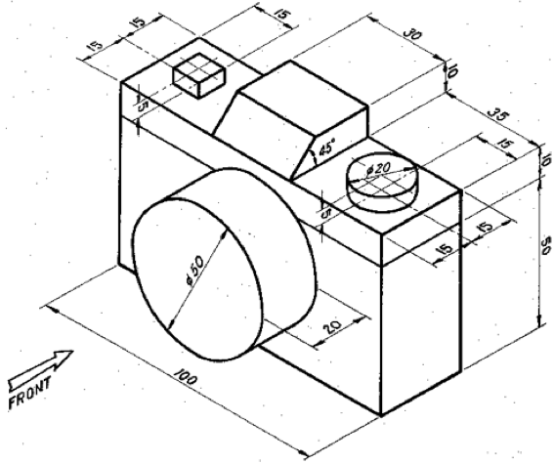
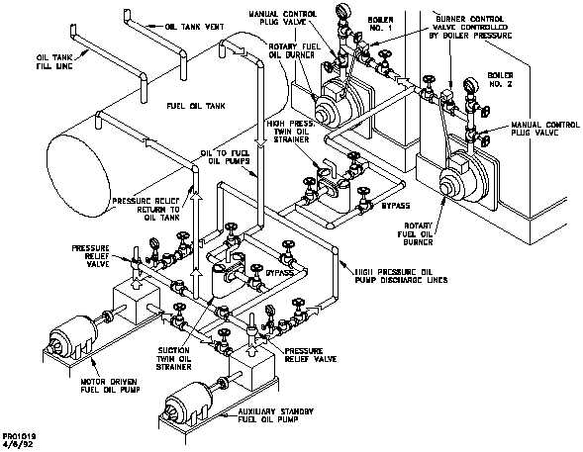

Slide 11
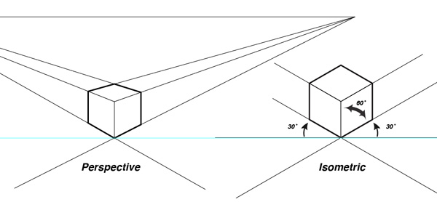
Similar to an isometric diagram is a perspective diagram, in a perspective diagram however, all the lines converge on a point “in the distance”. In Isometric, the lines are always parallel.
We are only looking at isometric drawings for now.

Slide 12
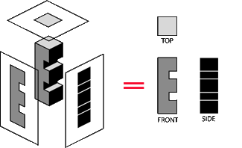
Orthographic views
Orthographic views are two-dimensional views of three-dimensional objects. Orthographic views represent the exact shape of an object as seen from one side at a time as you are looking perpendicularly to it.
Lines represent breaks in the surface

Slide 13
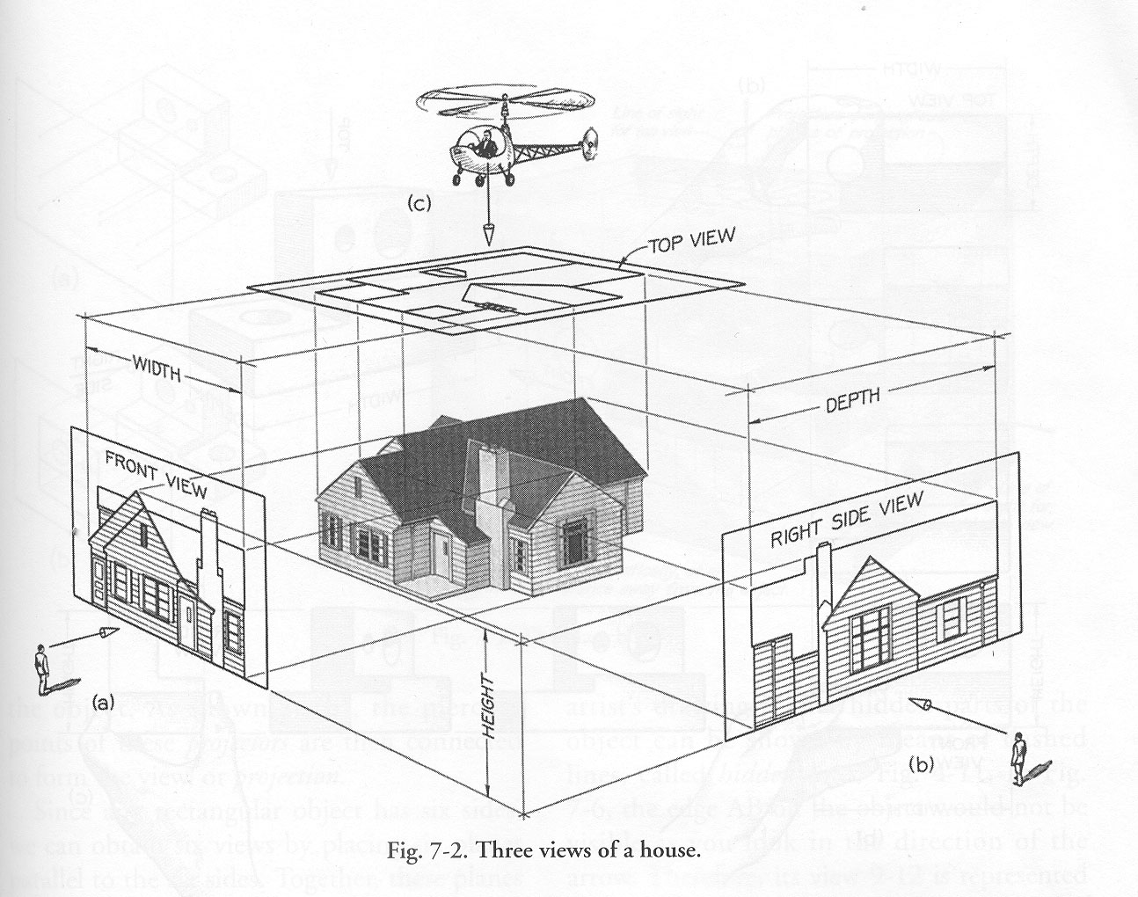
To create an orthographic view you need to draw the 2dimensional view of a 3dimensional object from the top, the side and the front.

Slide 14
Front
Left
Right
Back
Top
* Note: The dark lines indicated a break in the surface.

Slide 15
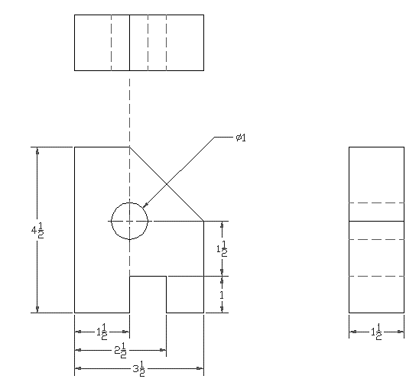
Dashed lines are used to show lines that are hidden when looking at the object from a certain perspective.

Slide 16
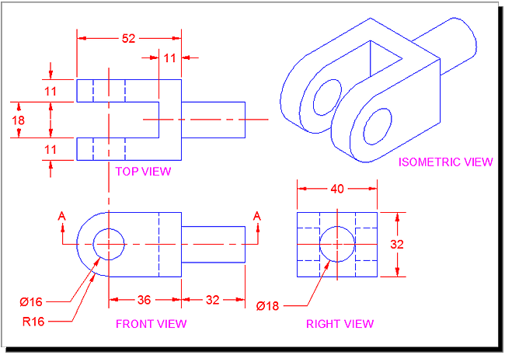
Often we use orthographic and isometric drawings together

Slide 17
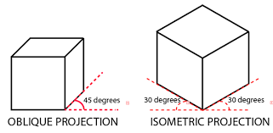
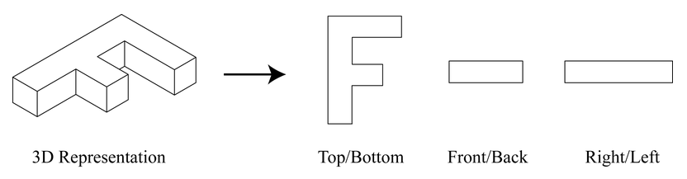
3D shape representations
EQ – How can we describe represent 3d objects?
A net is when you lay out the 2d pieces into a foldable shape that make the 3d object.
What is a net?
Isometric vs Oblique.
An oblique drawing has a leading face, the edges lead back at a 45º slant.
An isometric drawing has a leading edge, the left and right edges lead back at a 30º slant.
What is an orthographic drawing?
Orthographic views show a 3d object using 2d images of the top side and front viewpoints

